Slide 1
BLOXORZ
B07901020 劉昀昇

Slide 2
CONTENT
Brief introduction
Problem formulation
Bloxorz graph
CNF encoding
Definition
Rules
Experiment

Slide 3
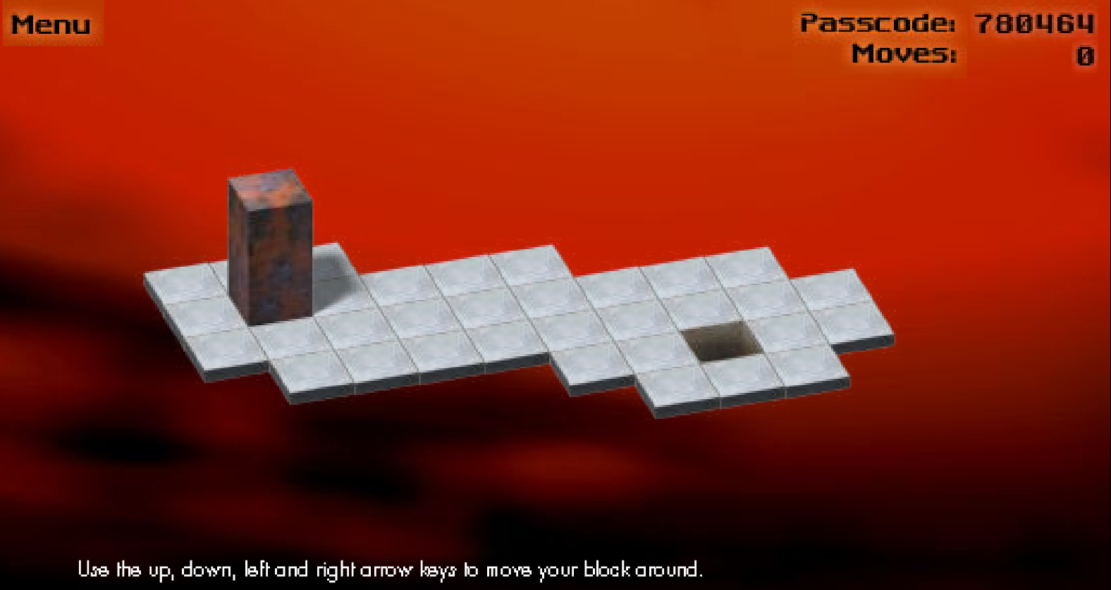
Brief introduction
https://www.mathplayground.com/logic_bloxorz.html
An online puzzle game where players move a 1 by 1 by 2 block by tilting it on a subset of the two dimensional grid. The block was moved from initial position to upright position on the destination square

Slide 4
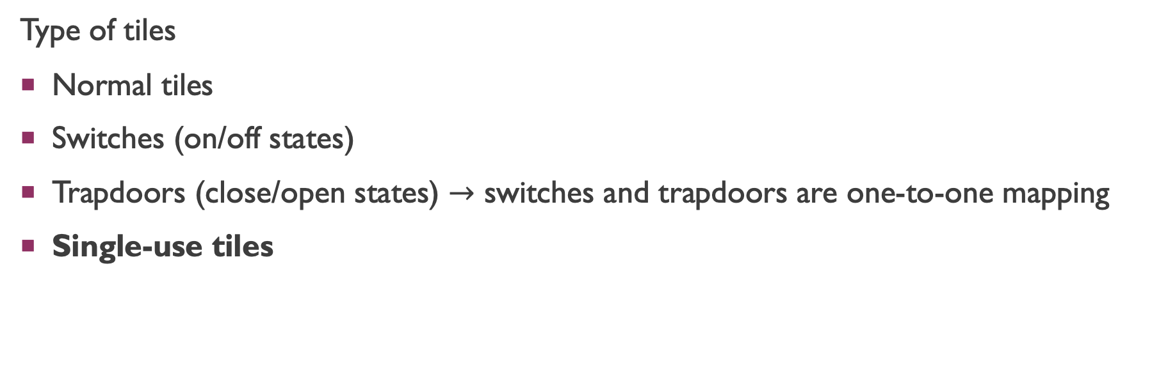
Brief introduction
Type of tiles
Normal tiles
Switches (on/off states)
Trapdoors (close/open states) $→$ switches and trapdoors are one-to-one mapping
Single-use tiles

Slide 5
Complexity of bloxorz
Van Der Zanden, Tom C., and Hans L. Bodlaender. "PSPACE-completeness of Bloxorz and of games with 2-buttons." arXiv preprint arXiv:1411.5951 (2014).
Dec. : decision problem
Opt. : optimization problem, whether it takes less than k steps
Here we focus on single-use tiles problem, it can be reduced from 3-CNF (NPC)

Slide 6
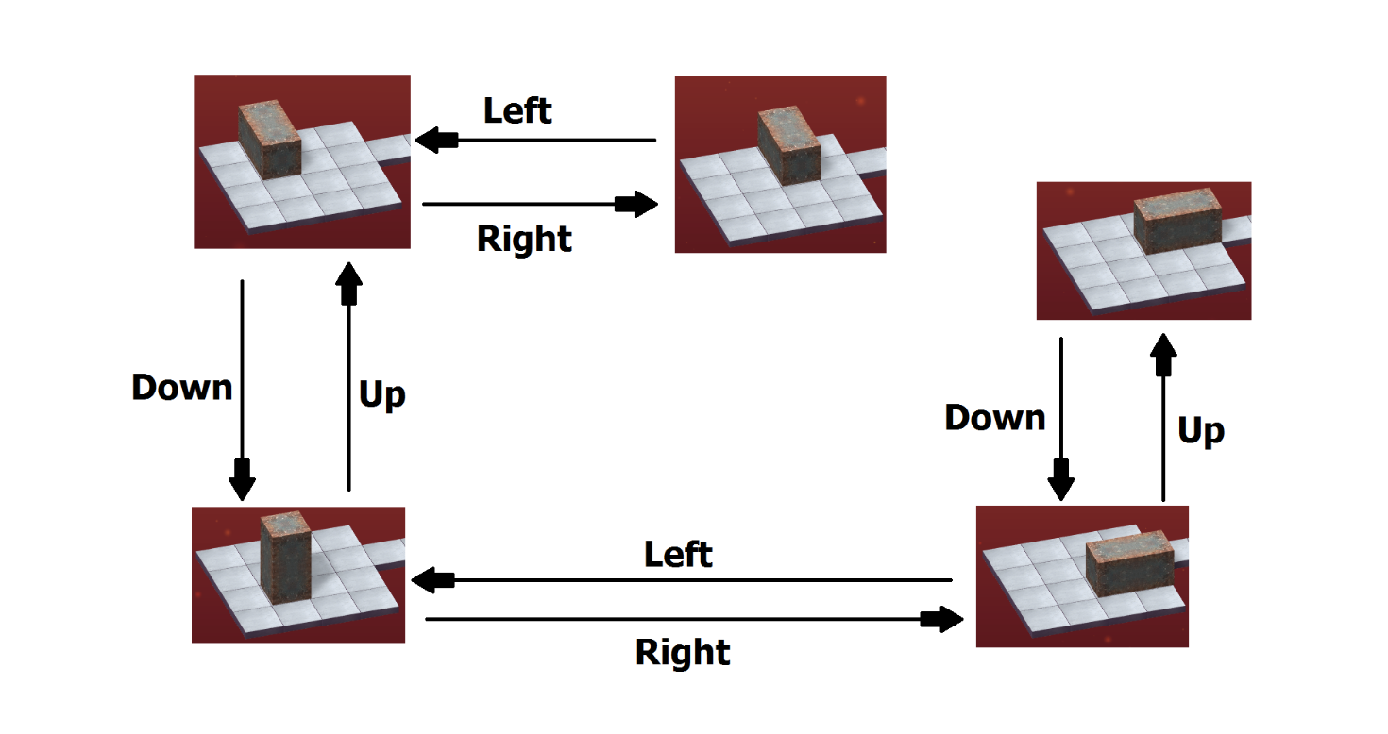
Problem formulation
Instance
Given a level of Bloxorz graph made up by a list of single-use tiles, and a 1 by 1 by 2 block
Question
Is there a sequence of legal move (right, left, down, up) to move from start point to up-right position on goal square

Slide 7
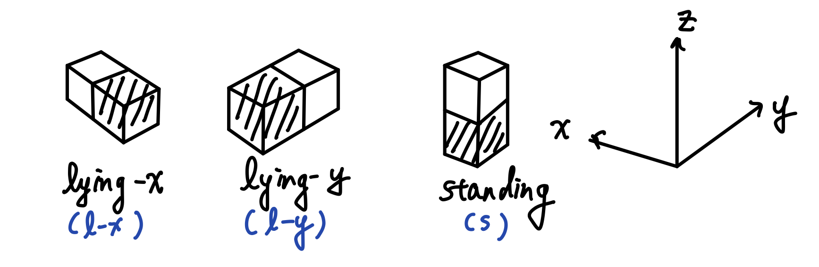

Bloxorz graph
Given a level of Bloxorz, suppose it has total $𝕋$ tiles. For each grid the block can have three unique states on it (choose the closer-to-origin unit). There are total $3∙|𝕋|$ vertices.

Slide 8
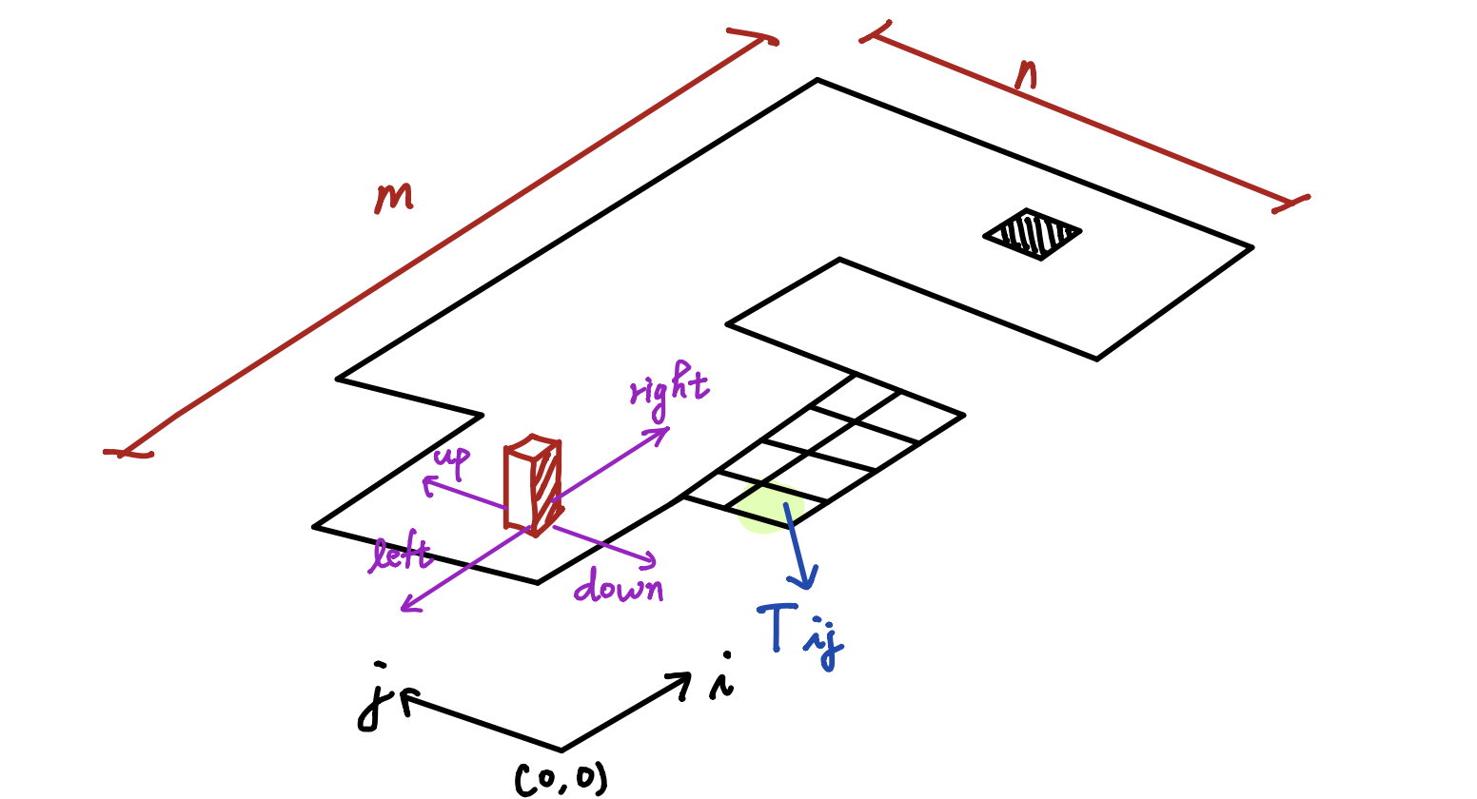
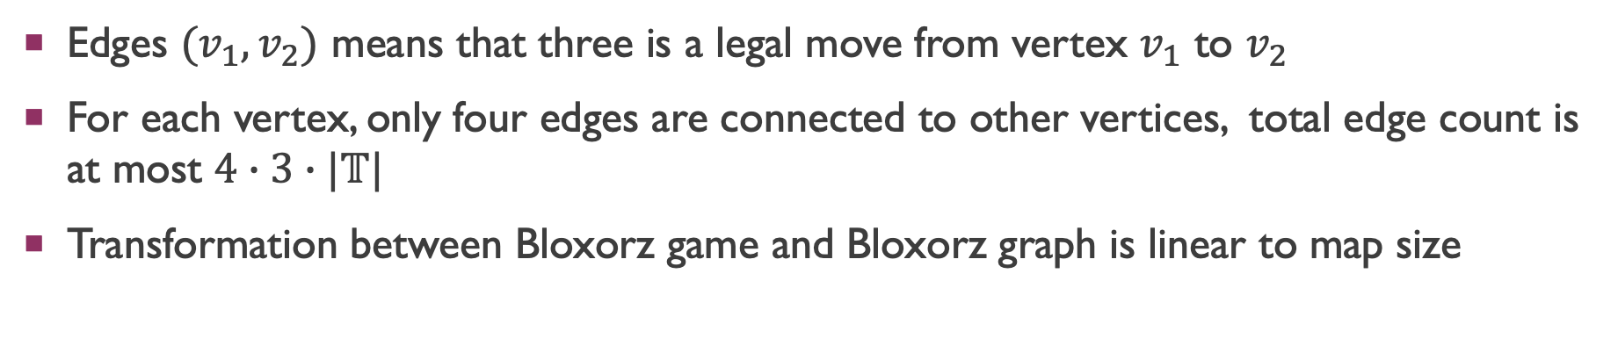
Bloxorz graph
Edges $(v_{1},v_{2})$ means that three is a legal move from vertex $v_{1}$ to $v_{2}$
For each vertex, only four edges are connected to other vertices, total edge count is at most $4∙3∙|𝕋|$
Transformation between Bloxorz game and Bloxorz graph is linear to map size

Slide 9
CNF encoding

Slide 10
Overall idea
Select a bunch of nodes on Bloxorz graph (these node incorporate location and state info of the block)
Check whether there exist a set of moves (edge) assigned on each selected nodes, to achieve path connection from start to end

Slide 11
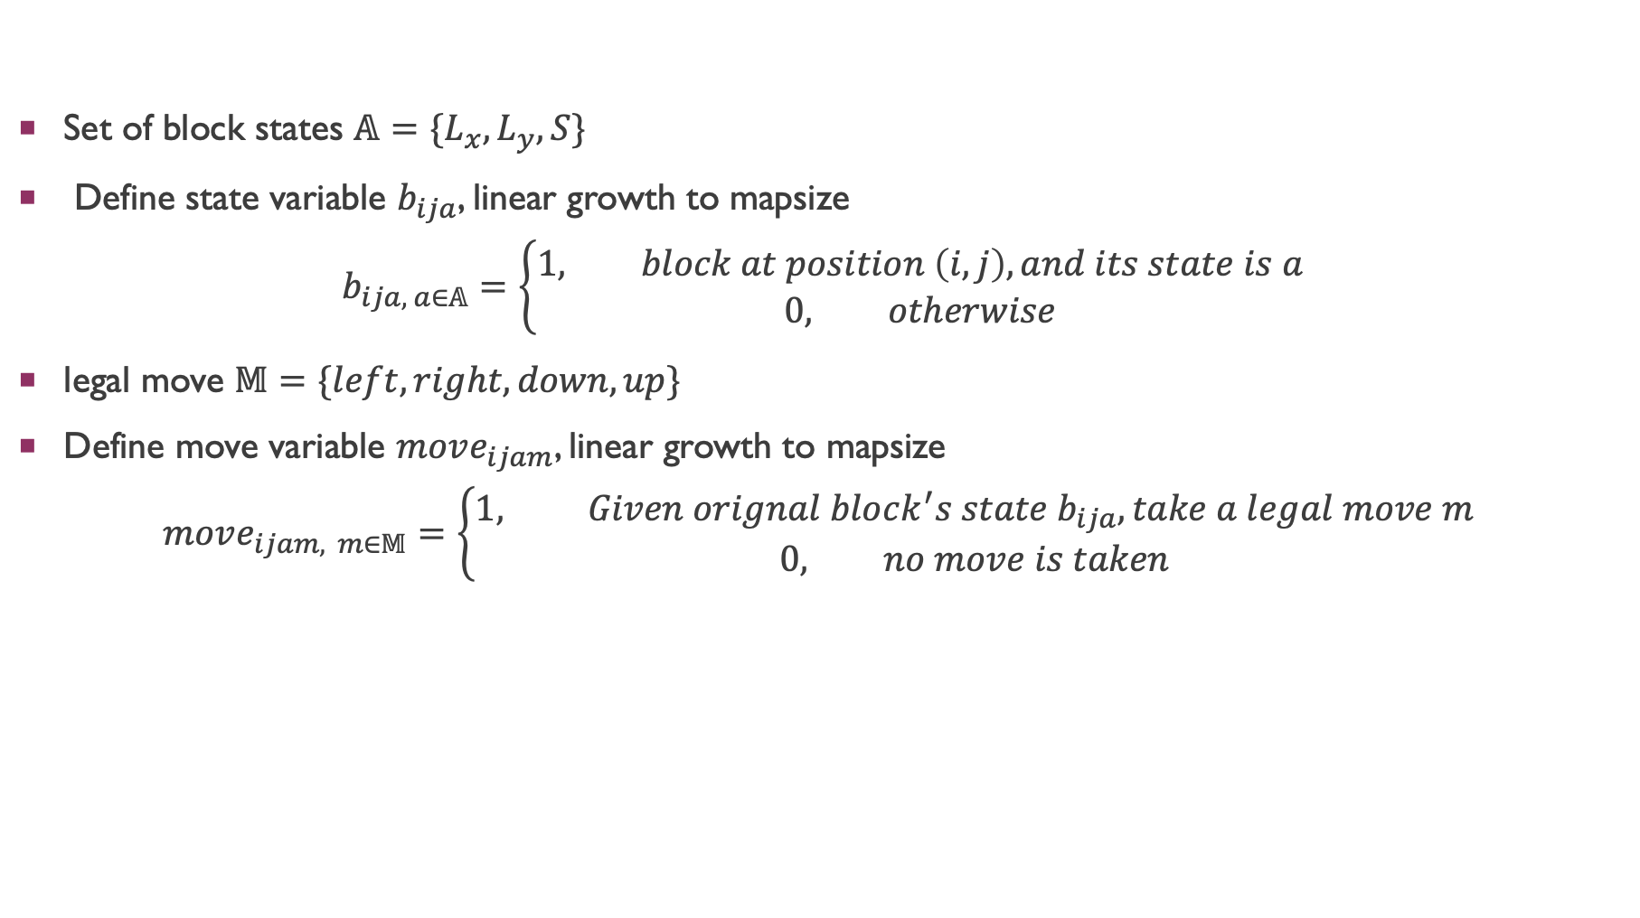
definition
Set of block states $𝔸=\{L_{x}, L_{y}, S\}$
Define state variable $b_{ija}$, linear growth to mapsize
$$b_{ija, a∈𝔸}=\left\{\begin{aligned}1, block at position \left(i, j\right), and its state is a \\ 0, otherwise\end{aligned}\right.$$
legal move $𝕄=\{left, right, down, up\}$
Define move variable $move_{ijam}$, linear growth to mapsize
$$move_{ijam, m∈𝕄}=\left\{\begin{aligned}1, Given orignal block^{′}s state b_{ija}, take a legal move m \\ 0, no move is taken\end{aligned}\right.$$

Slide 12
Rule
Since a tile can not be passed twice, a whenever a state is taken, some of states are no longer available
Block is originally stand at start point, and it must end standing at goal hole

